Slide 1
Data Base project comp 333
Dental Clinic

Slide 2
Ameer Yasen #1210187
Mujahed Abuali #1211047
Group Number: 8
Dr. Yousef Sabah

Slide 3
Introduction :
Dr. Yousef Najjar, a dedicated physician from the West Bank, seeks a robust database system to streamline his clinic's operations and patient care.
Recognizing the importance of data security, he desires a private system that can effectively manage:
Patient information: Securely store medical records, appointment details, and contact information.
Staff management: Facilitate collaboration among doctors and medical personnel by tracking schedules, roles, and responsibilities.
Financial transactions: Efficiently manage patient payments and expenses related to clinic materials.
Public information: Provide transparent access to essential clinic information for patients and the community.

Slide 4

Our team is committed to assisting Dr. Najjar in achieving his goals.
By constructing a customized and secure database system, we aim to improve the efficiency, accuracy, and accessibility of his clinic's data management.
This will ultimately enhance patient care and support Dr. Najjar's dedication to providing high-quality medical services in the West Bank.

Slide 5
Dental Clinic Database
ERD
UI
Table

Slide 6
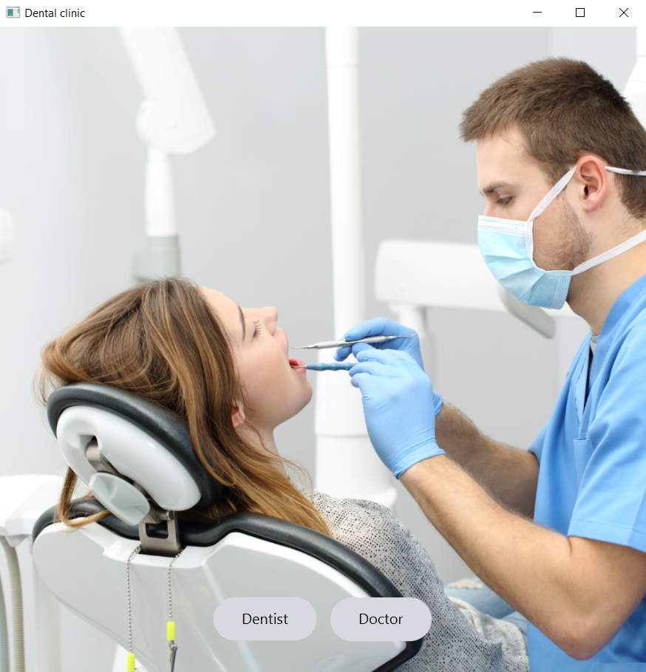
First screen
First thing when you run the program you have to choose to log in as a Doctor or Dentist
This is the main screen
Dentist
Doctor

Slide 7
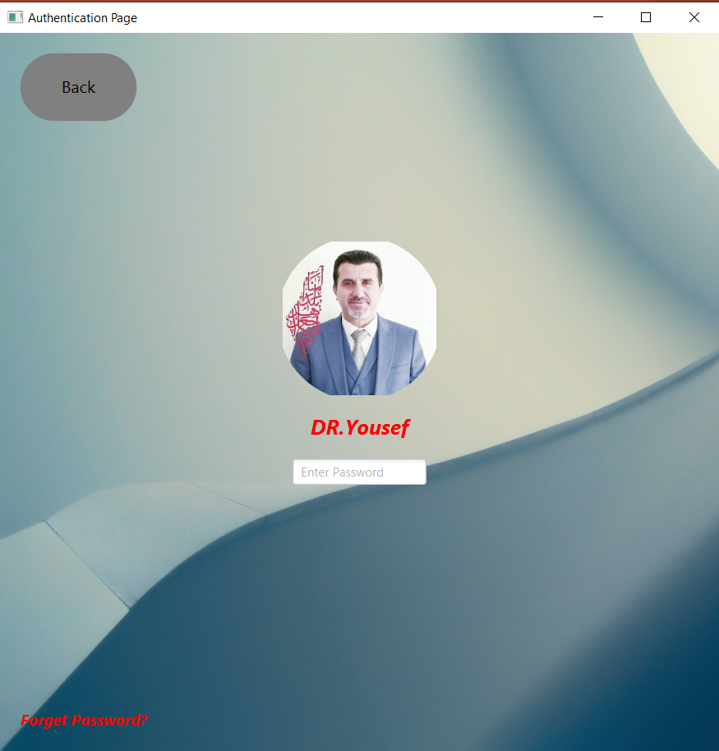
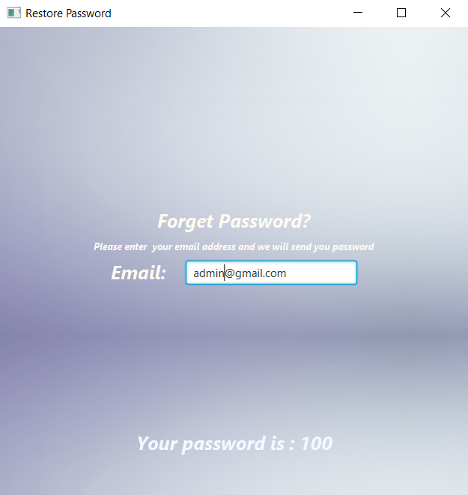
Log in as the Doctor
As the Doctor of the clinic, you have admin permissions and a profile
First of all, you enter your password
Hint its ‘100’
And if you forgot your password you can get it back with your email from the choice under ‘Forget password?’
And of course, the back button takes you back to the first screen

Slide 8
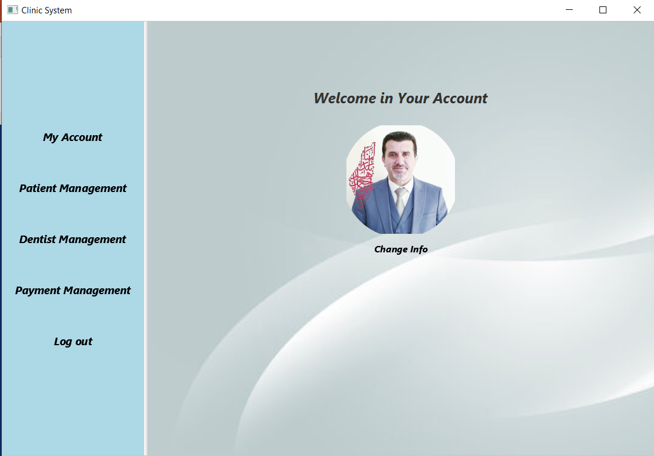
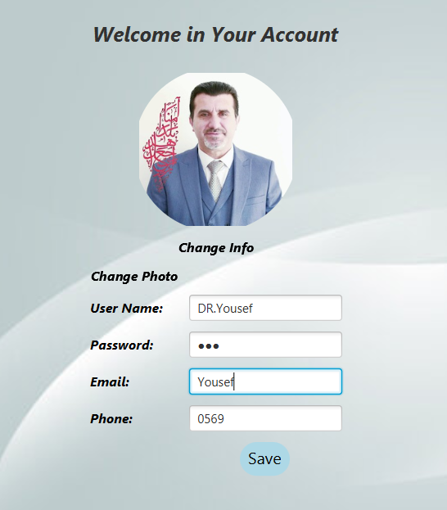
This is the main page when login to the Doctor account
From this page, you can change your information
and get access to
Patient Management
Dentist Management
Payment Management
Lets see them one by one

Slide 9
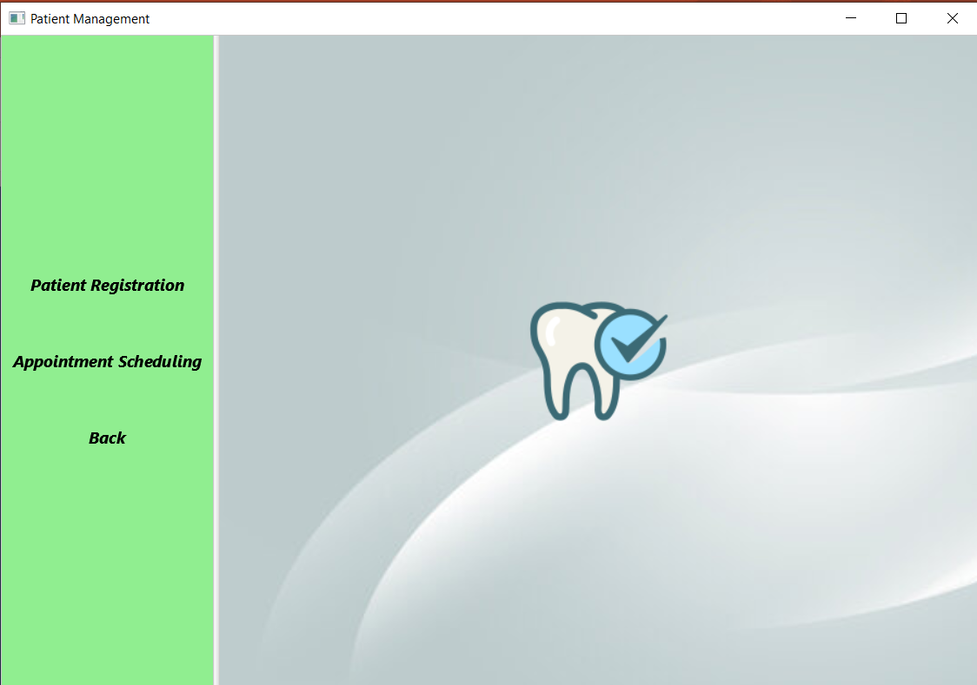
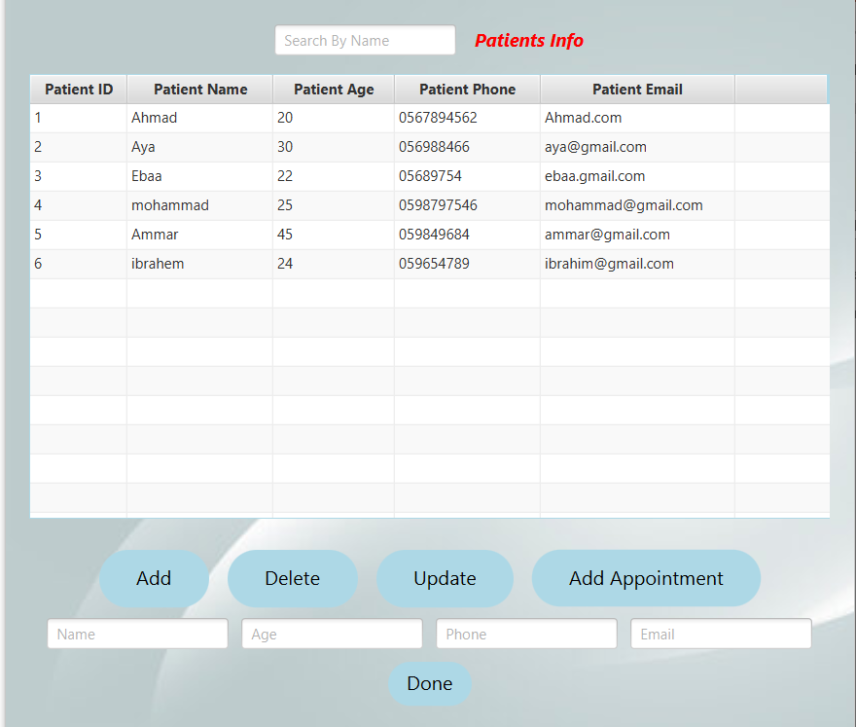
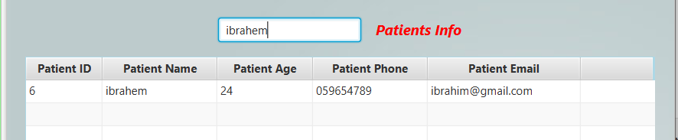
Patient Management
From here you can enter a new patient into the database and schedule a new appointment for him or delete or update the appointment
Or you can change the patient’s information or delete his information from the database
Fast lookup for the patients with search by name text Field, write the name of the patient or part of it and the table will filter patients by their names

Slide 10

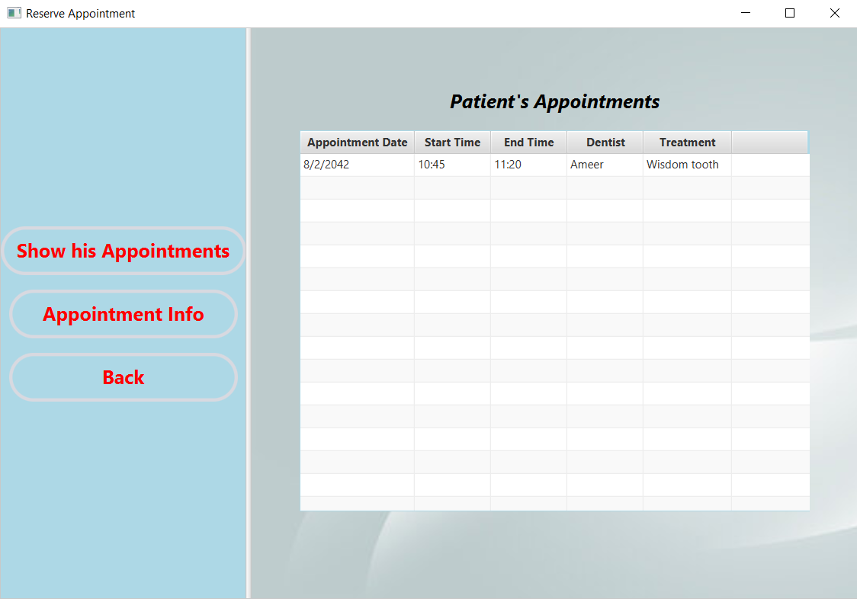
To update, Delete or add an Appointment
First, you choose the patient from the table by click on the row then press the button
When click on add appointments it will take you to this page where you can check the patient appointments and add a new one when click here

Slide 11
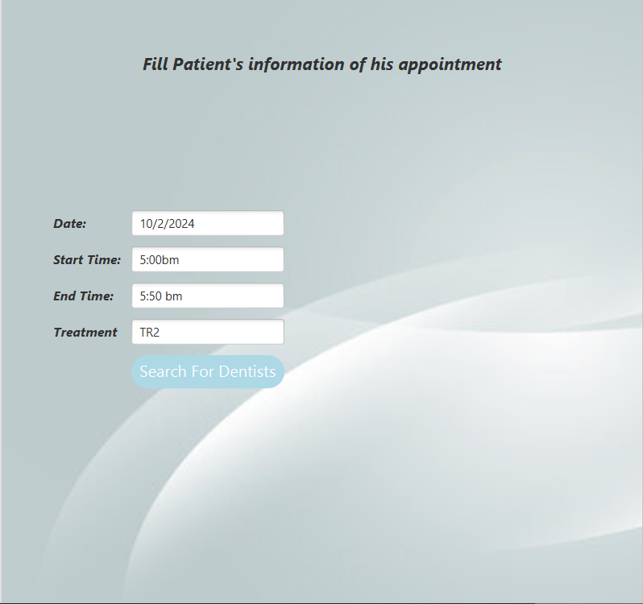
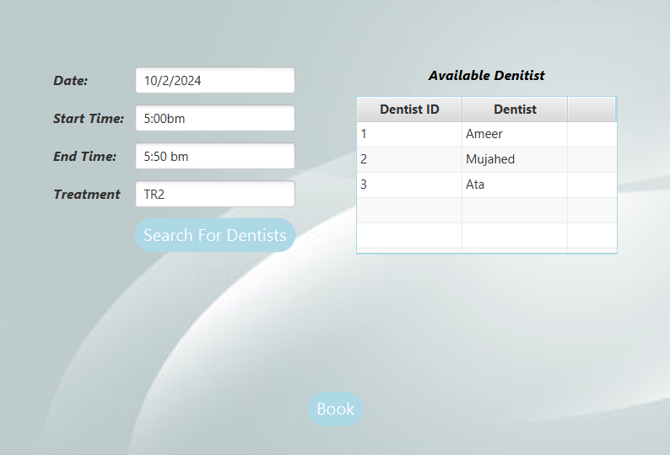
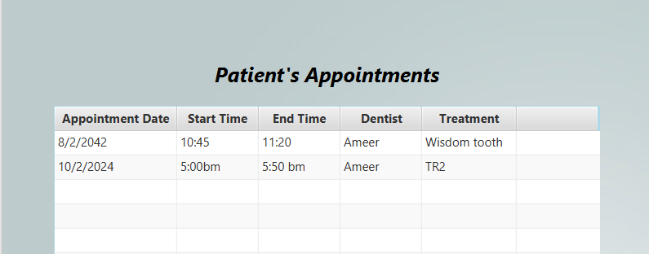
Fill the appointment details
Then assign it to one of the dentists in the clinic

Slide 12
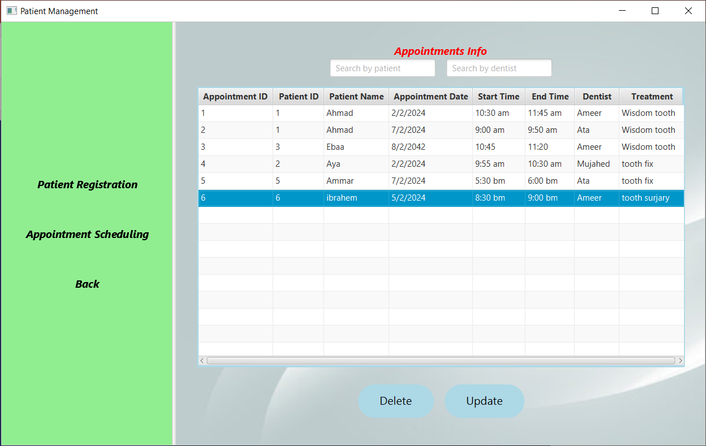
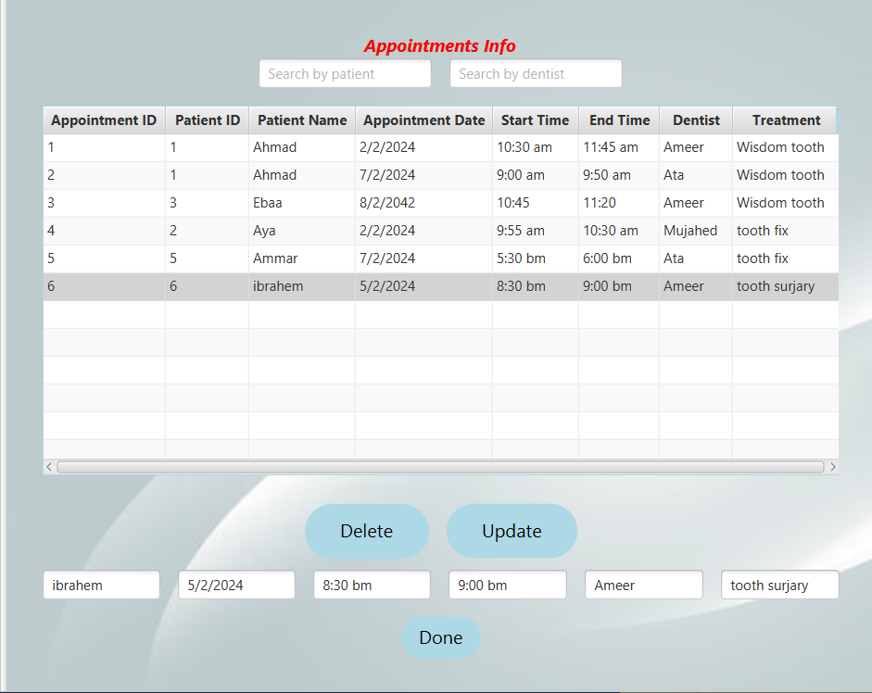
Now let’s go back to the patient management screen
From here you can see all appointments in the clinic and which patients with any dentist, and you can delete or update any appointment information
You can search for an appointment by the patient’s name or dentist’s name

Slide 13
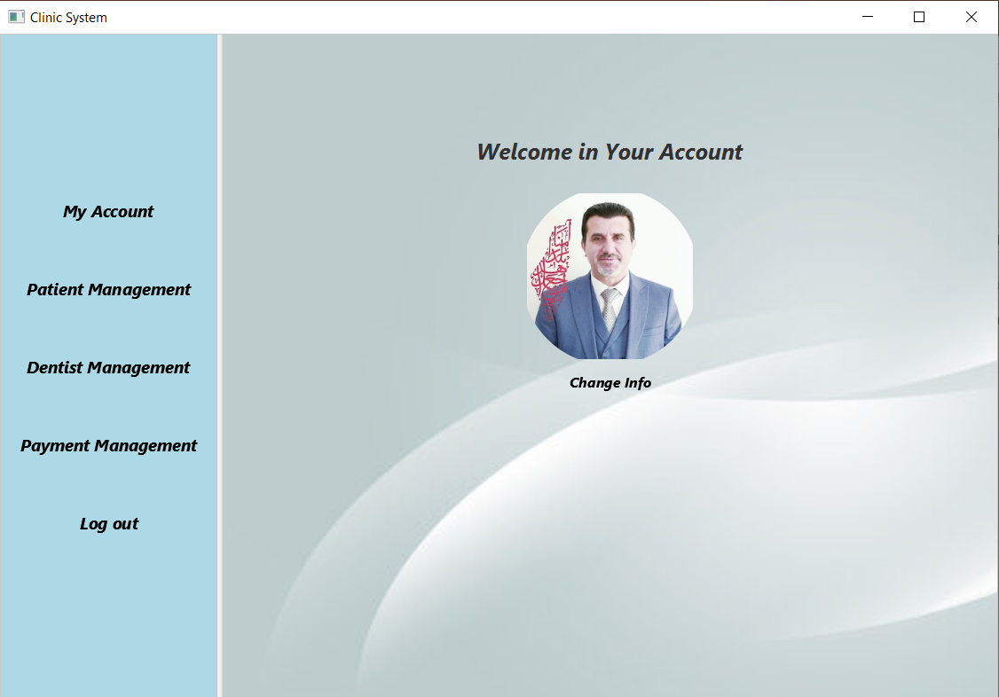
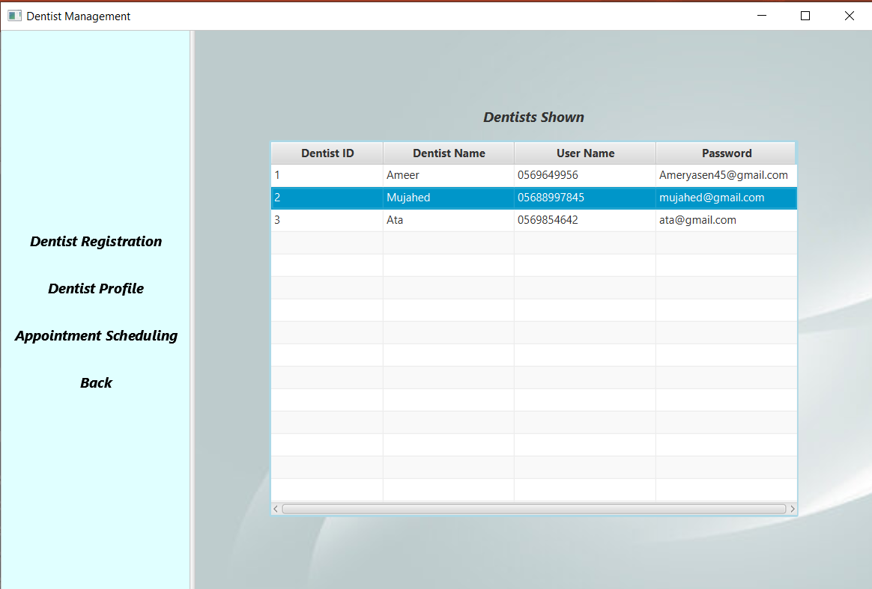
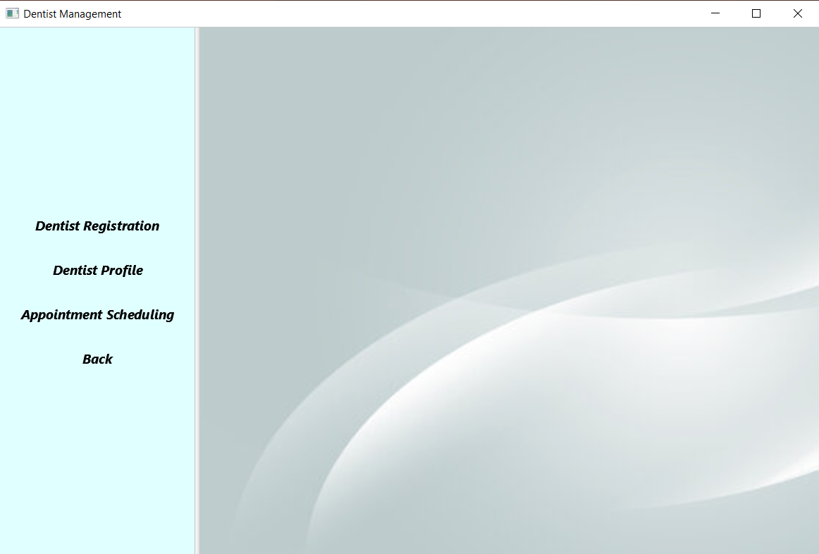
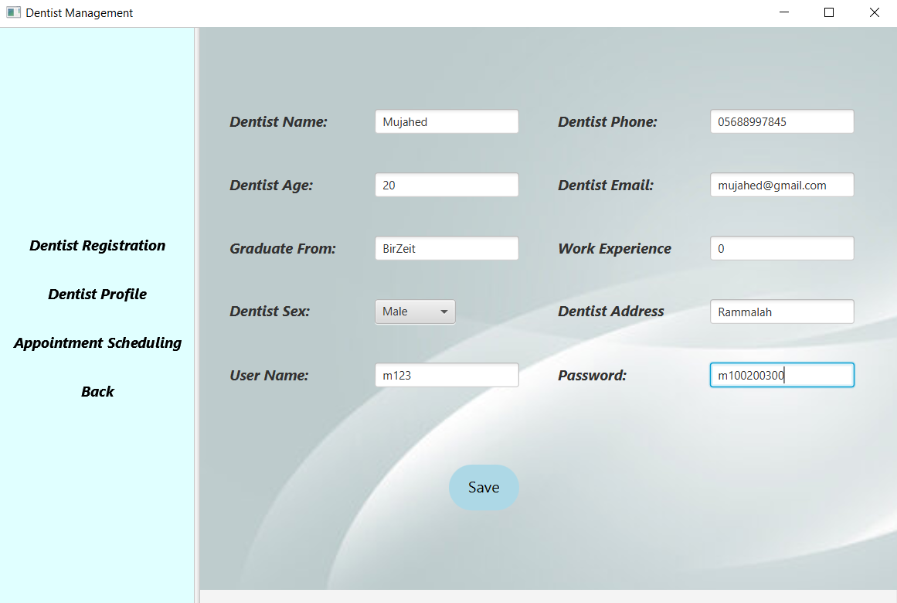
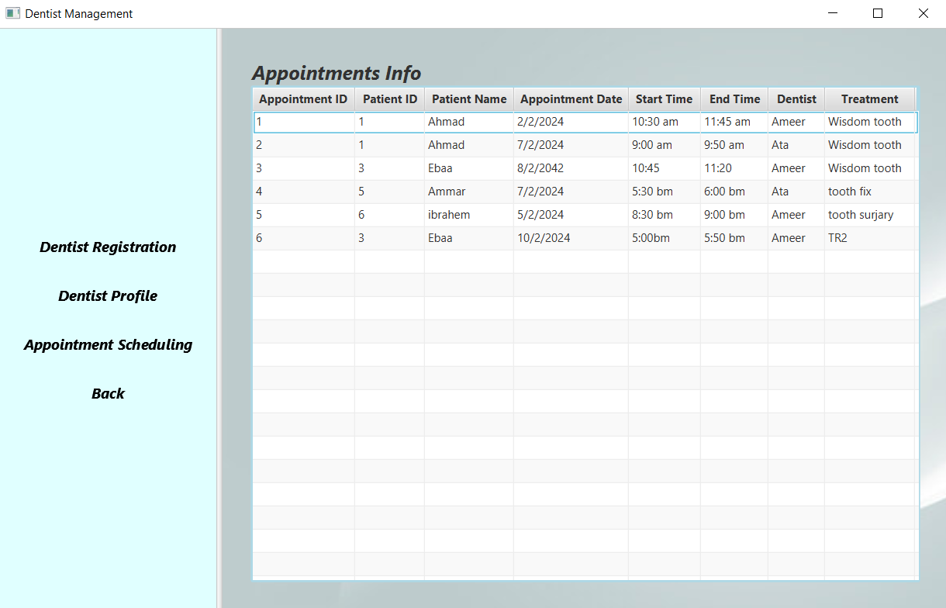
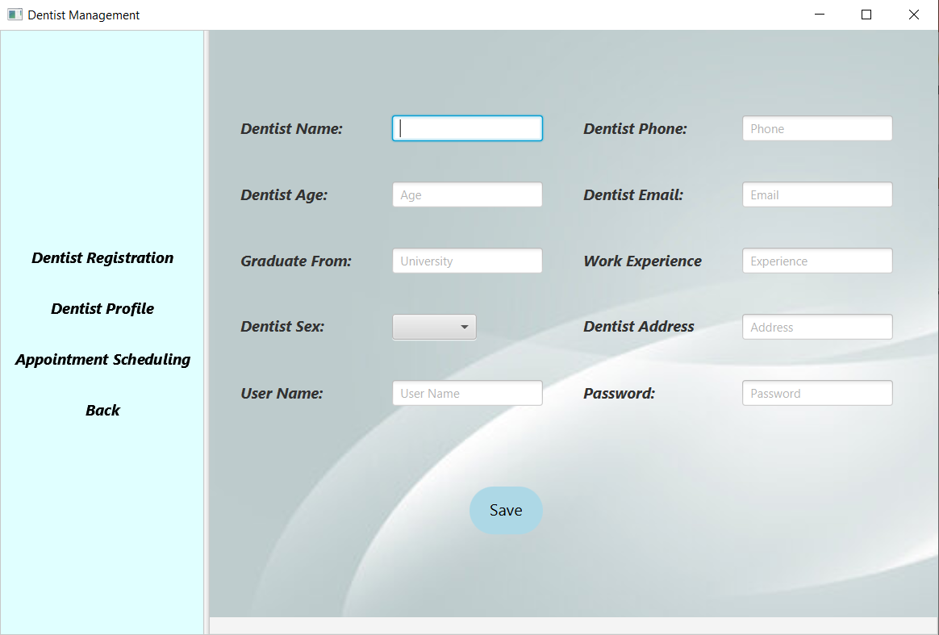
Let’s go back to the first screen and choose Dentist Management
From this screen, the doctor can add a new dentist account to the database after taking his information
By clicking on dentist registration
Lets add Mujahid the new dentist you hired
Then click on the save button
Now the dentist profile table
From here we can see that Mujahed’s information was added to the database and you can update or delete a profile by double-clicking on the row of the name
You can access the appointment schedule from this screen but we already saw it in previous slides
Lets continue

Slide 14
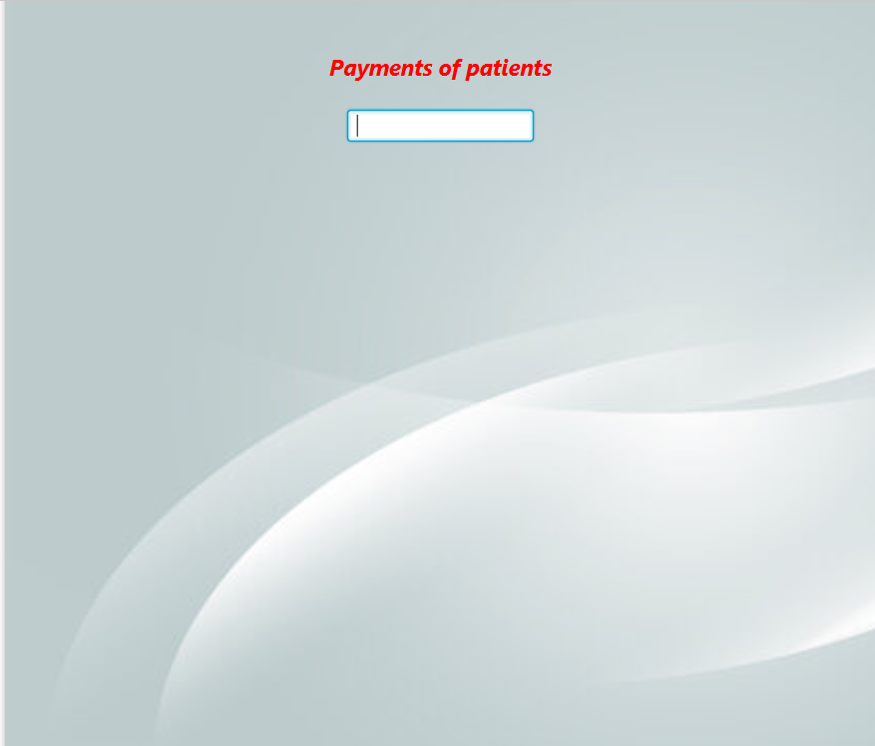

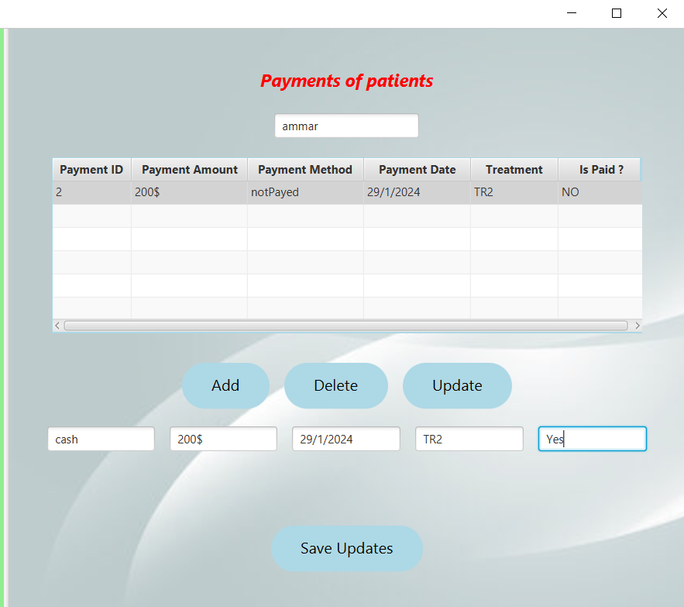
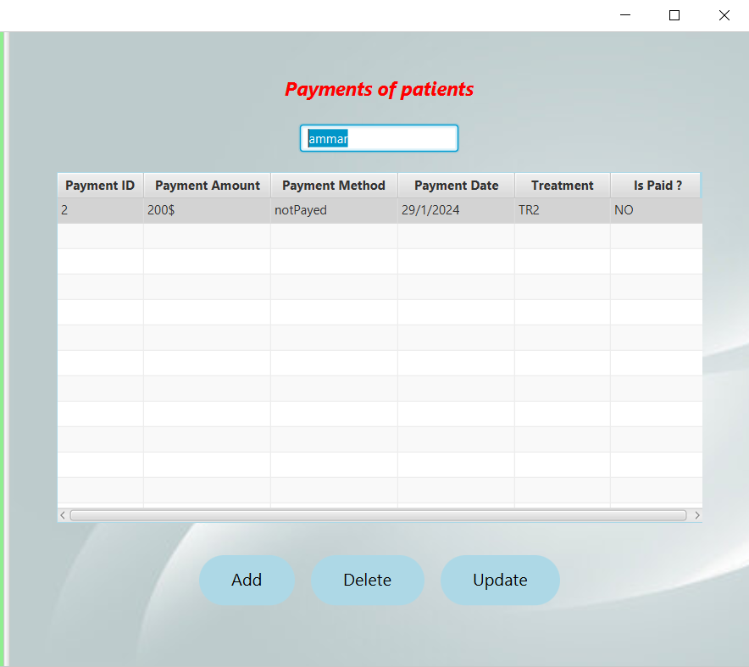
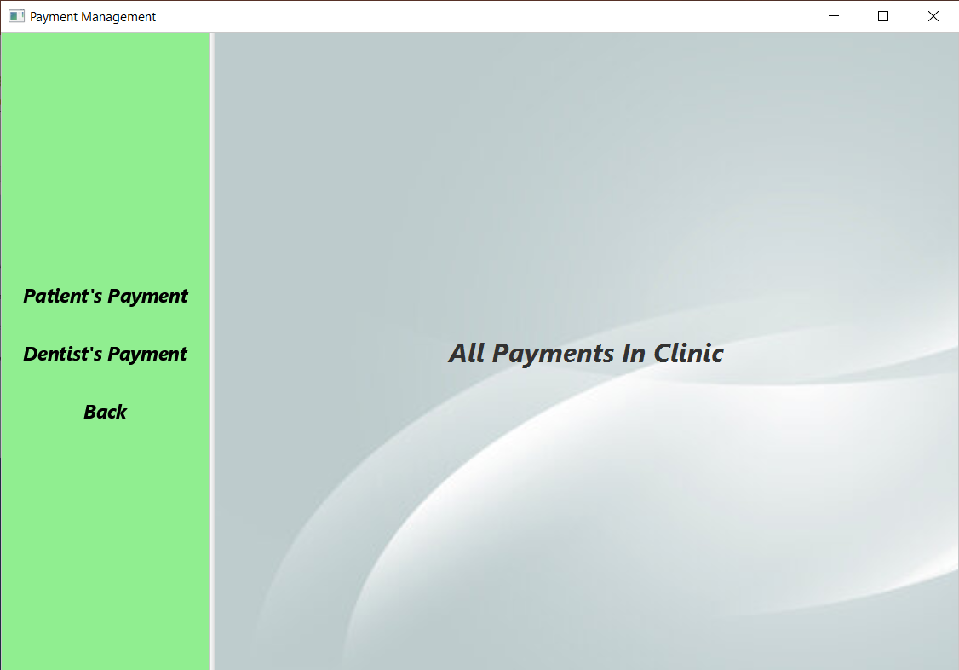
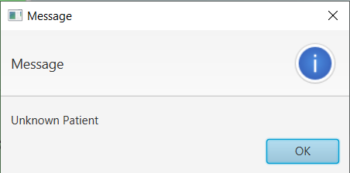
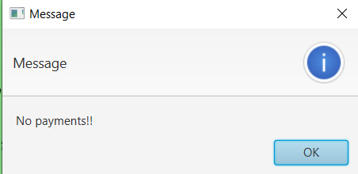
Payment Management
The doctor has access to patients’ and dentist payments
Patients Payment:
First, you need to look up the patients name patient’s
Let’s see Ammar for example
Ammar had an appointment on 29/1/2024 but he didn’t pay that time now he paid and you have to save that payment into the system
He did pay all the money in cash
If the patient has no account the table won’t appear and a message will pop up ,if he has no payments before the system will tell you
OR

Slide 15
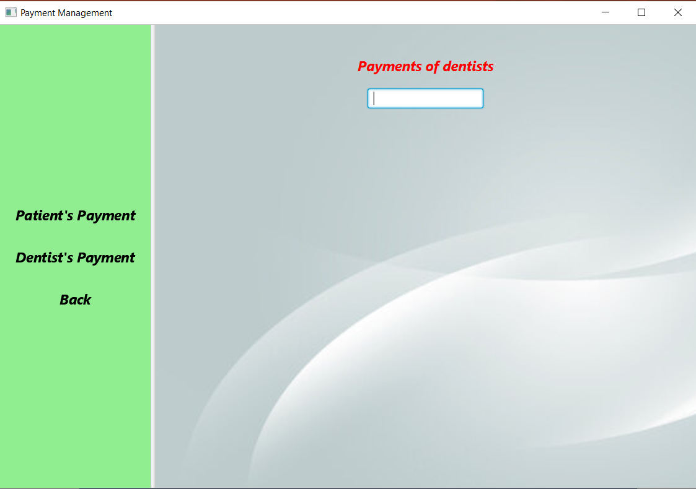
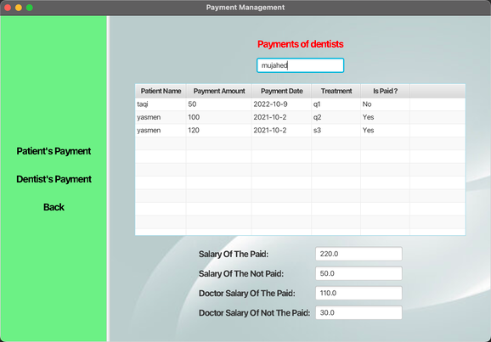
Payment of dentist:
Payment method like this :
If the patient pay in cash the dentist get 50% of the profit and if the patient did not pay yet or pay in check then the dentist get 30% of the payment added to his salary

Slide 16
Now we go back to the first screen
First Screen

Slide 17
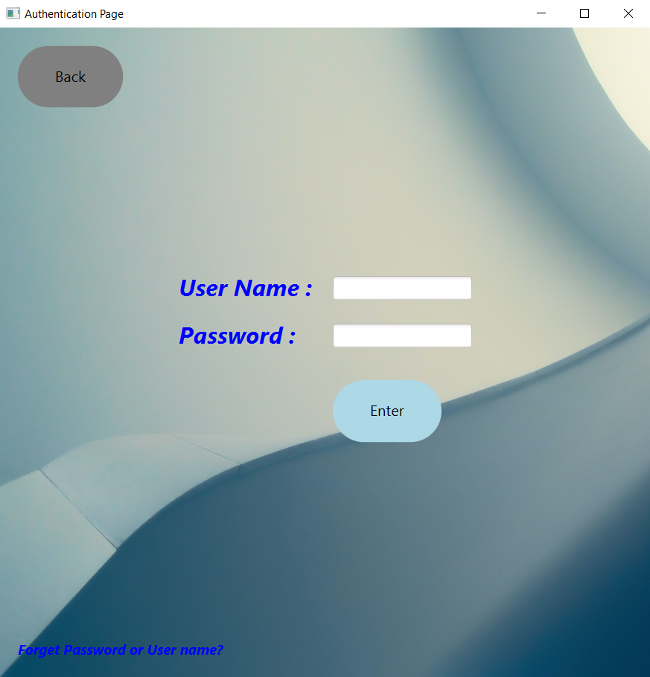

We log in to the program as a Dentist
He has a strange user name ‘redZone’ , looks like he play a lot of video games
The Doctor has the authority to make an account for any dentist who works in the clinic
Let’s log in as Ameer the Dentist with the most experience in the clinic

Slide 18

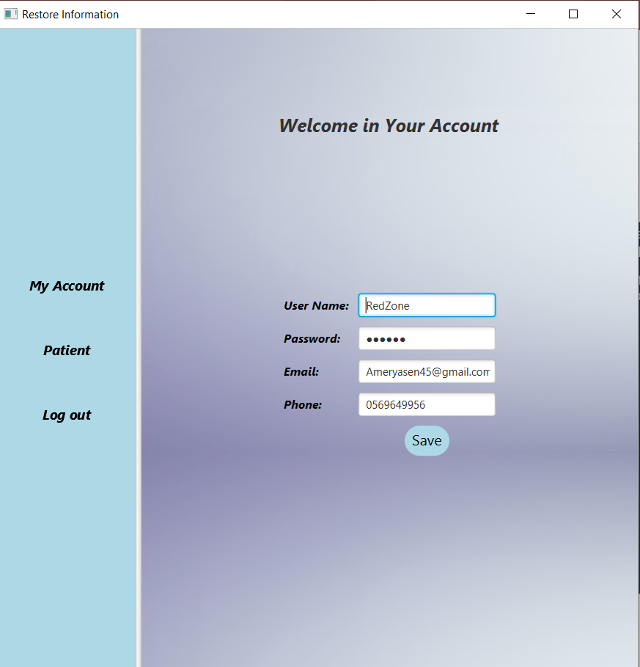
From here you can get access as a dentist to your patient’s information and appointments
Also, you can change your profile information and your account password, etc…
Let’s go to the patient’s screen

Slide 19
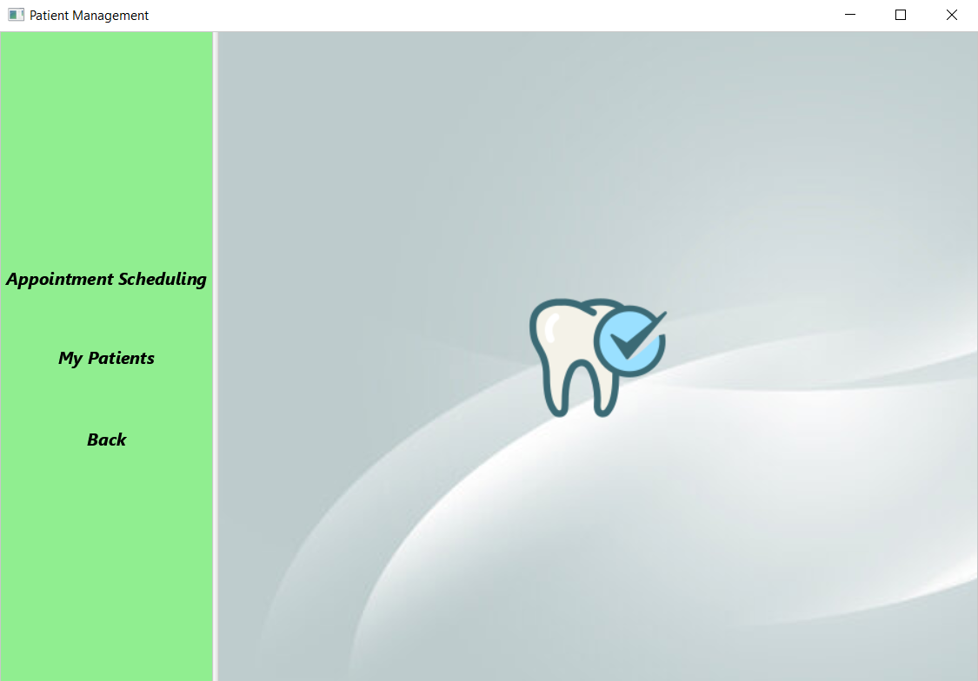
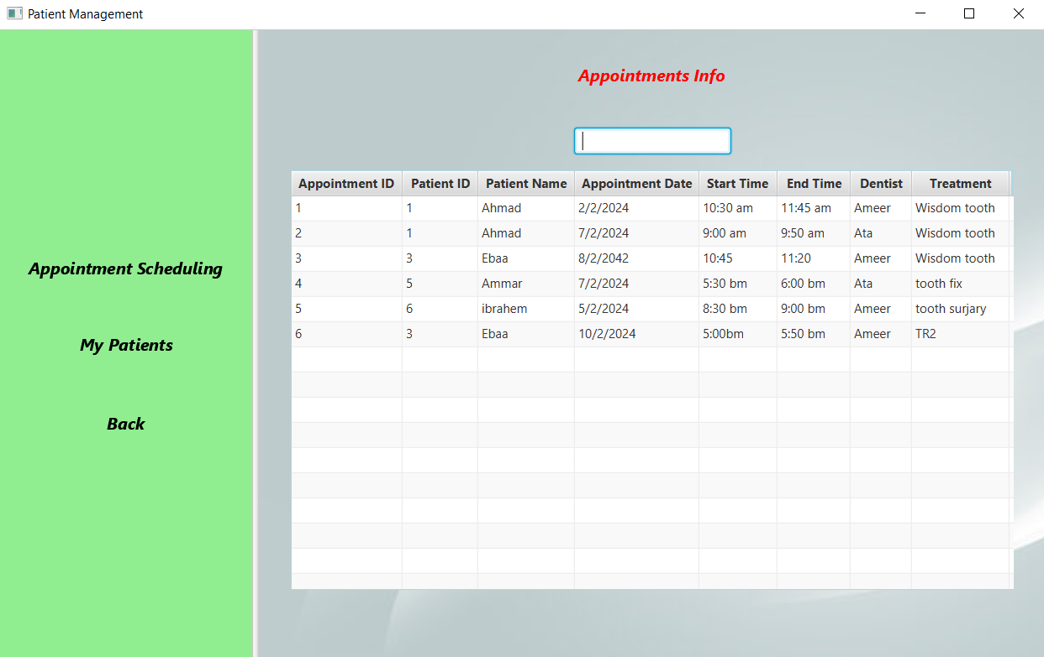
Patients management:
First , we have the appointment schedule
You can click on the other option ‘My Patients’ to see all the appointments you have with your patients with the order for the early appointments
From here the dentist can see all the appointments that are scheduled for him and all dentists in the clinic

Slide 20
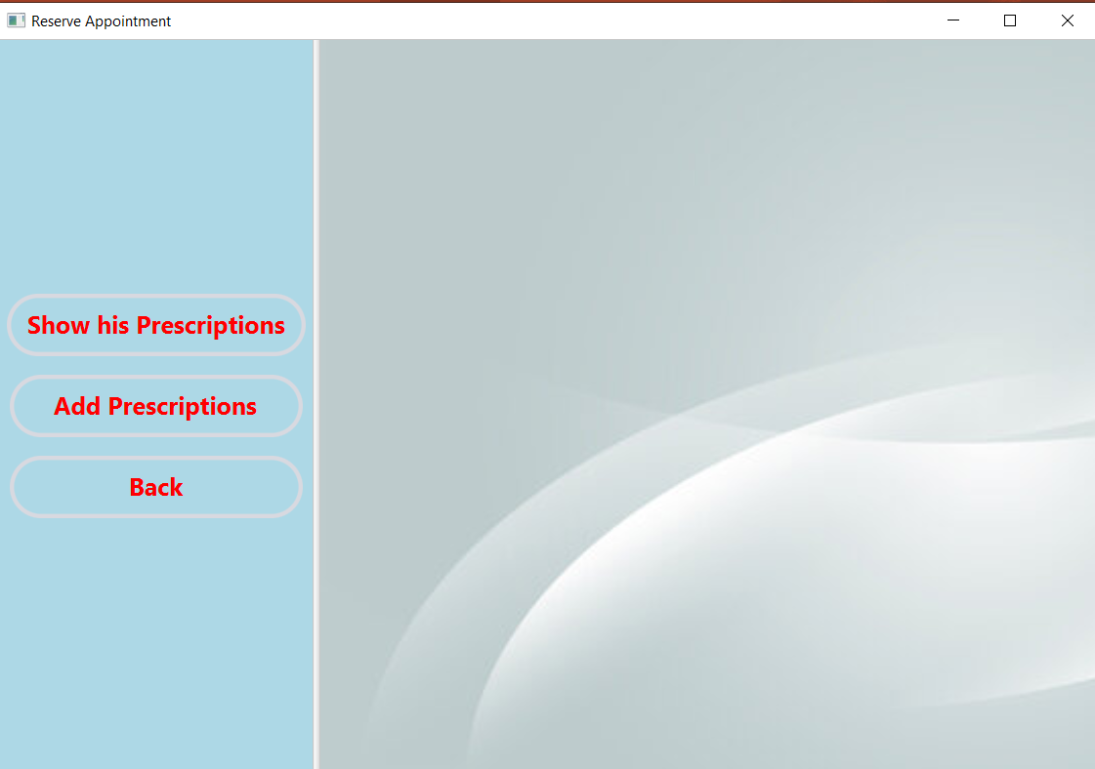
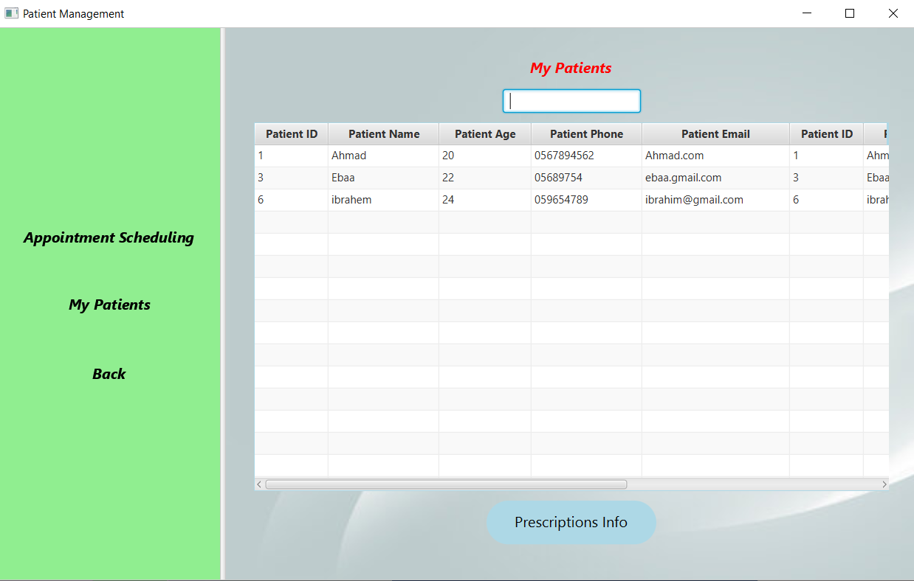
From here you can add a prescription for your patient
From this screen you can see all the prescriptions you gave to your patient
Let’s choose Ahmad
And you can give him a new prescription
You can filter the table view by names if you want
Lets see Ahmad prescriptions

Slide 21
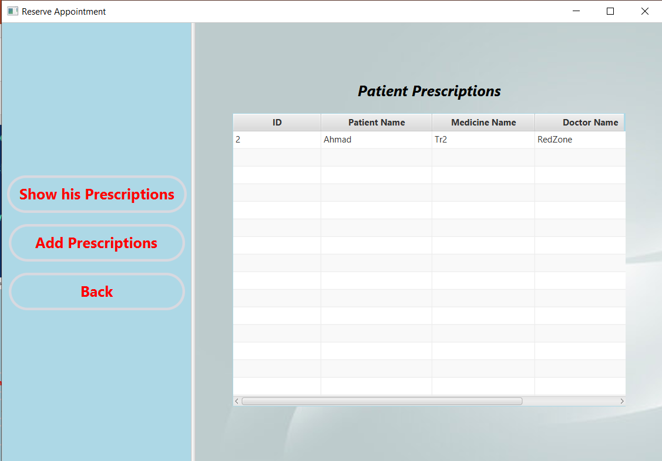
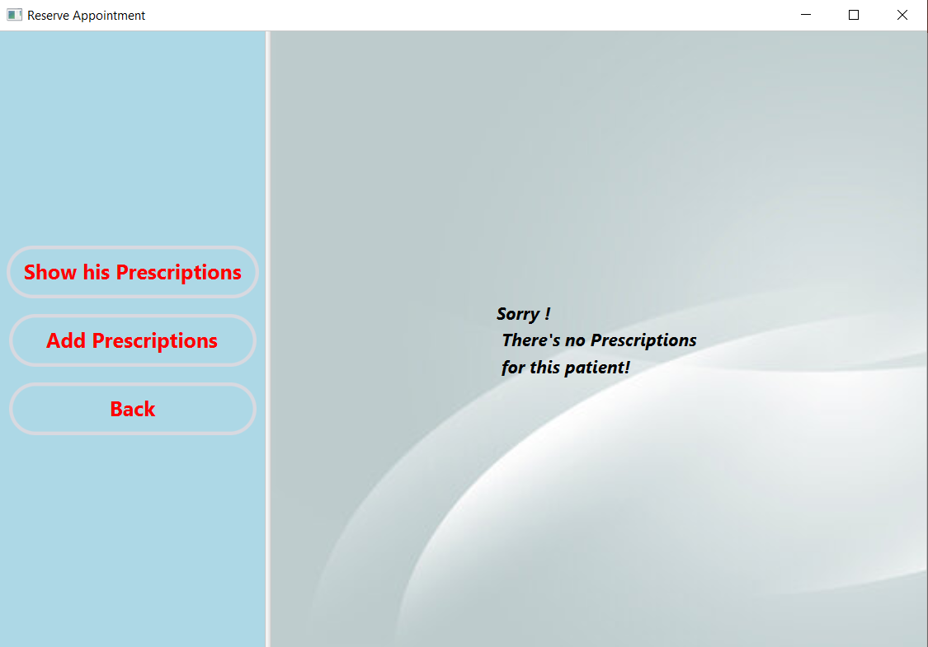
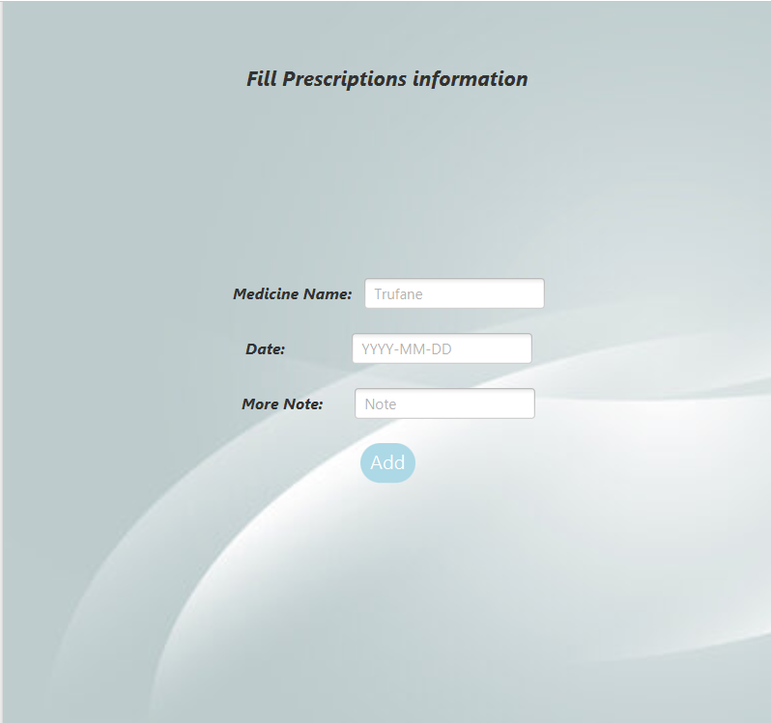
You did not write a prescription for Ahmad yet
First ,you write the medicine name
Click on add prescription
Write the date
Then your notes of how using it and how many times a day and so on
We will prescribe him Tr2 medicine 3 times a day
Then click on add

Slide 22
First Screen

Slide 23
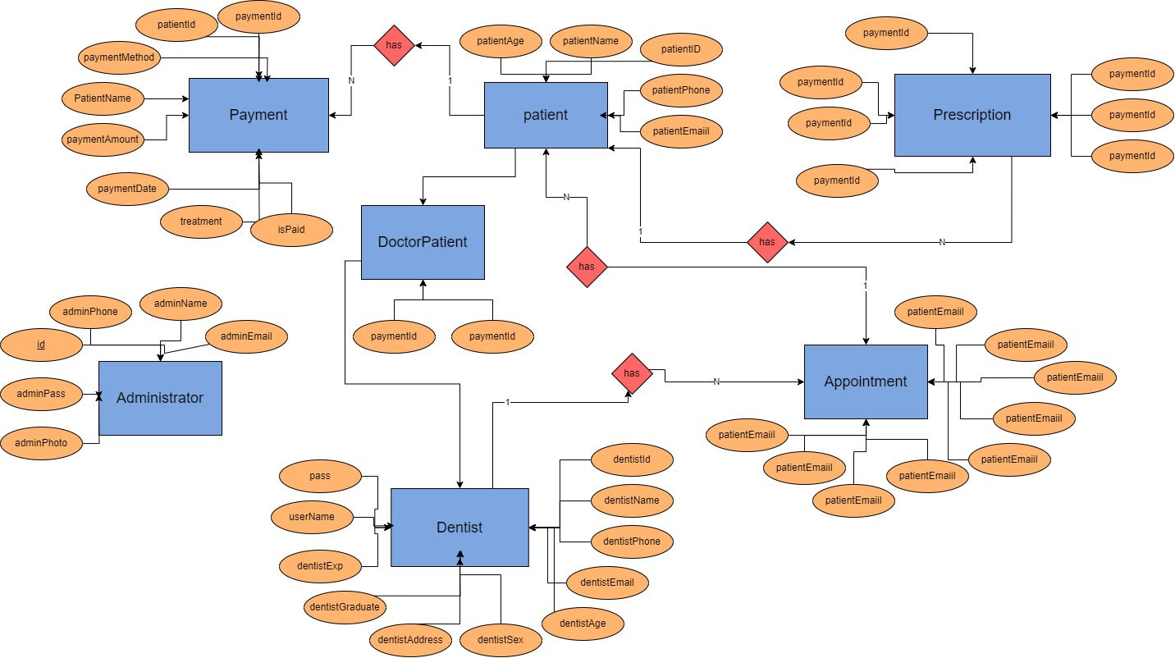

Slide 24
Entities: Administrator (id, adminName, adminPass, adminEmail, adminPhone, adminPhoto) Patient (patientId, patientName, patientAge, patientPhone, patientEmail) Appointment (appointId, patientId, dentistId, patientName, dentistName, appointDate, appointStart, appointEnd, treatment) Dentist (dentistId, dentistName, dentistPhone, dentistEmail, dentistAge, dentistSex, dentistAddress, dentistGraduate, dentistExp, userName, pass) Payment (paymentId, patientId, PatientName, paymentMethod, paymentAmount, paymentDate, treatment, isPaid) Prescription (id, date, name, patientId, doctorId, patientName, doctorName) DoctorPatient (dentists_id, patient_id) Relationships: Patient has many Appointments (one-to-many) Dentist has many Appointments (one-to-many) Patient has many Payments (one-to-many) Dentist issues many Prescriptions (one-to-many) Patient has many Prescriptions (one-to-many) Dentist has many Patients (many-to-many, represented by the DoctorPatient table)

Slide 25
